Slide 1

CYBERSECURITY RESEARCH PROJECT
PHISHGUARD
A Real-Time Anti-Phishing Browser Extension
Developed by Worship Muguti

Slide 2
THE PROBLEM
EXPLOITING TRUST
Phishing attacks remain the most pervasive cybersecurity threat, tricking users into revealing passwords and financial data.
Bypasses standard vigilance
Malicious links via Email & Messaging
Automation is now a necessity

Slide 3
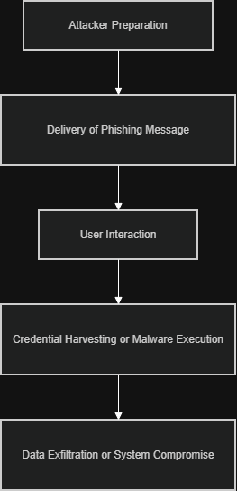
THE PROCESS

Slide 4



REQUIREMENT ANALYSIS
USER NEEDS
SYSTEM NEEDS
Non-technical users require a seamless experience. Protection must be invisible until a threat is detected, using subtle alerts rather than intrusive popups.
Cross-browser compatibility (starting with Chrome). Low resource footprint is critical to ensure zero degradation of browsing speed.

Slide 5
CURRENT MARKET GAPS
Existing Solution | Primary Method | The PhishGuard Advantage
Google Safe Browsing | Blacklist Only | Real-time ML Analysis for Zero-day threats
Norton Safe Web | Proprietary Lists | Open Source Transparency & Hourly Updates
Avast Security | Bulky Extension | Lightweight Client-side processing

Slide 6






OPEN SOURCE INTELLIGENCE
PHISHTANK
OPENPHISH
URLHAUS
Community-driven blacklist with hourly API updates. Core of our dual-layered lookup system.
Specialized active feed. PhishGuard accounts for the 12-hour free-tier delay.
Used to cross-reference malware distribution domains for multi-threat detection.

Slide 7
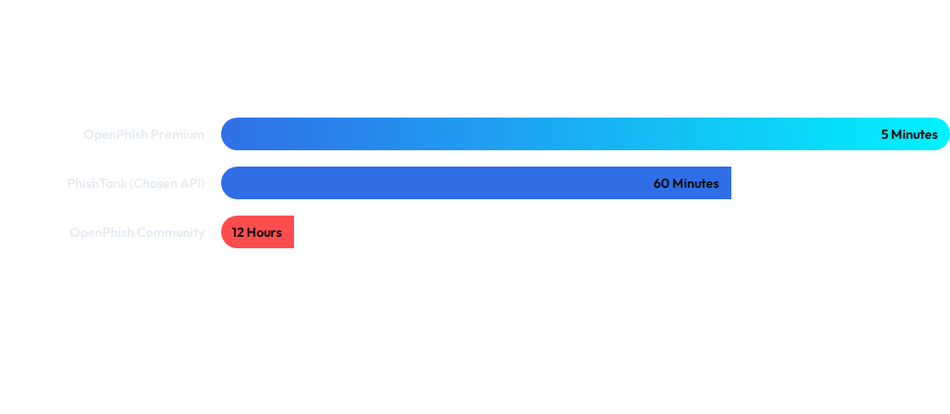
DETECTION FRESHNESS
Update frequency is the #1 factor in catching "Short-lived" phishing pages.

Slide 8

MACHINE LEARNING LAYER
CLASSIFICATION FEATURES
URL Features: Length, IP address presence, and suspicious character counts.
RISK ANALYSIS
The classifier calculates a risk score for any URL not found on established blacklists, identifying novel threats in milliseconds.
Domain Data: Age of domain, registration length, and keyword red-flags.
Algorithms: Random Forest and Decision Trees via Scikit-learn.

Slide 9
STRATEGIC GOALS
98%
PERFORMANCE STANDARDS
My focus is minimizing the False Positive Rate to ensure the extension remains helpful rather than intrusive. Success is measured by accuracy vs browser load impact.
IF EVERYTHING WORKS CORRECTLY, IT SHOULD HAVE A DETECTION ACCURACY TARGET OF 98%

Slide 10
TECH FEASIBILITY
PROVEN STACK
Leveraging well-documented APIs like Chrome Extensions and PhishTank. The ML component is built using industry-standard Python Scikit-learn.
The solution is financially viable, relying entirely on open-source tools and free API tiers, keeping development costs minimal.

Slide 11
DEVELOPMENT ROADMAP
PHASE 2
PHASE 4
Real-time Interceptor
ML API Deployment
PHASE 1
PHASE 3
Structure & Chrome UI
Blacklist Integration

Slide 12
DEMONSTRATION OF HOW THE EXTENTION SHOULD WORK
https://youtu.be/sP9XxmjJkEc?si=M0rXoyCeZM9924sS

Slide 13

THE FUTURE OF PHISHGUARD
Expanding protection to Firefox and Edge, implementing real-time email content analysis, and launching a centraliSed enterprise dashboard for organiSational threat monitoring.

Slide 14
QUESTIONS?
Secure your browsing experience with PhishGuard.
Worship Muguti | Project Lead
Real-Time Cybersecurity Solutions

